Slide 1


SMART INDIA HACKATHON 2026
TITLE PAGE
Problem Statement ID – SIH26196
Problem Statement Title – Student Innovation
Theme – Smart Education
Live Demo – Herb Nexus
PS Category - Software
Team ID – N/A
Team Name - Neural Nexus

Slide 2

Problem and Solution
Neural Nexus
Our Problem
Innovation & Uniqueness
🌿India loses 20% of medicinal plant species to illegal wild harvesting annually
📍No centralized system to track, verify, or monitor rare botanical species
⚖️ Medicinal-plant sourcing lacks end-to-end traceability, increasing the risk of adulteration and illegal trade
🚜 Existing platforms help farmers sell medicinal plants, but do not verify the plant, assess its conservation risk, or track it from source to final batch.
◆ Conservation-First AI
AI prediction is validated before conservation decisions
◆ Risk-Based Intervention
GIS + threat data prioritize vulnerable species
◆ Conservation-to-Cultivation Model
Permitted species can shift from wild collection to cultivation
◆ Source-to-Batch Traceability
Cultivated material remains linked to its verified source
Our Solution
📸AI-assisted plant identification from photo + field data
✅Expert validation converts predictions into verified records
🗺️GIS maps verified observations and analyzes distribution, history and threats
⚠️Conservation-risk assessment prioritizes species for action
🔍Normal-risk species → routine monitoring
🚨Rare/high-risk species → conservation & research assessment
🌱Permitted species → propagation and controlled cultivation
🔗Cultivated material → source-to-batch traceability
📦Verified cultivated supply → legitimate sourcing

Slide 3

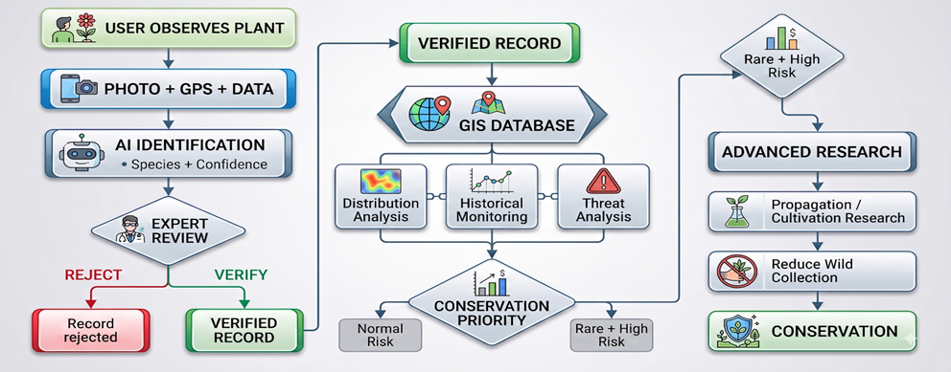










TECHNICAL APPROACH
Neural Nexus
Central Workflow
Techstack
Frontend -
Next.js + TypeScript + Tailwind CSS
Backend - FastAPI + Python
Database- PostgreSQL + PostGIS
AI / ML-
PyTorch + EfficientNet/ResNet50 (PlantNet dataset)
GIS - MapLibre GL JS
Charts - Recharts
Authentication - JWT
Deployment - Docker + Render

Slide 4

FEASIBILITY AND VIABILITY
Neural Nexus
Feasibility
❖ Built using mature open-source technologies: Next.js, FastAPI, PostgreSQL/PostGIS and PyTorch.
❖ Transfer learning enables development of specialized plant-identification models without requiring a model trained from scratch.
❖ PostGIS provides spatial storage and GIS analysis for plant observations.
❖ Expert-in-the-loop verification reduces dependence on AI-only identification
❖ Docker enables reproducible deployment and scaling.
❖ MVP can be developed incrementally: AI identification → expert review → GIS dashboard → cultivation → traceability.
Potential Challenges
Viability
⚠️ AI misidentification
⚠️ Similar-looking plant species
⚠️ Limited rare-species training data
⚠️ Low-quality user photographs
⚠️ Expert availability
⚠️ Illegal wild collection
⚠️ Sensitive species locations
⚠️ Changing legal requirements
🛡️ Conservation Monitoring
🌱 Sustainable Cultivation
🔗 Batch Traceability
👨‍🌾 Cultivator Support
🔬 Research Data
🏭 Legitimate B2B Supply

Slide 5

IMPACT AND BENEFITS
Neural Nexus
FARMERS
Prototype
Benefits
Connects farmers with verified buyers and creates opportunities to sell medicinal plants at better market value
Helps farmers identify suitable medicinal plants and supports scientifically and legally approved cultivation.
Verified & Traceable Produce.
Protects Rare & Medicinal Plants
Promotes Sustainable Cultivation
AI + Expert Verification
End-to-End Traceability
Connects Legitimate Buyers & Producers
Enables Better Conservation Decisions
GOVERNMENT
Better Conservation & Monitoring
Transparent & Traceable Supply Chain
Data-Driven Decision Making
Demo Link
https://herbnexus-frontend.onrender.com/

Slide 6
RESEARCH AND REFERENCES
Neural Nexus
National Medicinal Plants Board (NMPB) — Ministry of Ayush https://nmpb.ayush.gov.in/
e-Charak — Ministry of Ayush https://echarak.ayush.gov.in/
India Biodiversity Portal https://indiabiodiversity.org/
Pl@ntNet — AI Plant Identification https://docs.plantnet.org/en/understand/how-the-identification-model-works/
iNaturalist — Computer Vision + Biodiversity Observations https://www.inaturalist.org/

